Slide 1


How Active Is Your Fund Manager? A New Measure That Predicts Performance
K. J. Martijn Cremers & Antti Petajisto
Review of Financial Studies | 2009

Slide 2
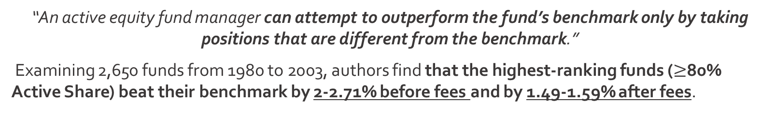
The Premise
WSU
Introduction
“An active equity fund manager can attempt to outperform the fund’s benchmark only by taking positions that are different from the benchmark.”
Examining 2,650 funds from 1980 to 2003, authors find that the highest-ranking funds ($≥$80% Active Share) beat their benchmark by 2-2.71% before fees and by 1.49-1.59% after fees.
Stock Selection
Involves picking individual stocks that the manager expects to outperform their peers.
The Characteristic Selectivity (CS) measure, if you will
Factor Timing
Involves time-varying bets on systematic risk factors such as entire industries, sectors of the economy, or any systematic risk relative to the benchmark index
Because many funds favor one approach over the other, it is not clear how to quantify active management across all funds.

Slide 3

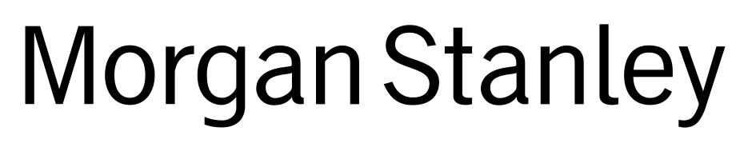
Tracking Error
WSU
Definitions
The Traditional Way:
The “volatility” (variability) of the difference between a portfolio return and its benchmark index return.
The two distinct approaches (stock selection and factor timing) contribute very differently to tracking error – either may still produce a high alpha
Here, tracking error is lower simply because individual stock picks allow for greater diversification, even while potentially contributing to a positive alpha
Small Cap – “pure stock picker” which hopes to generate alpha with stock selection within industries
American Opportunities – “sector rotator” which focuses on actively picking entire sectors and industries to outperform the benchmark

Slide 4
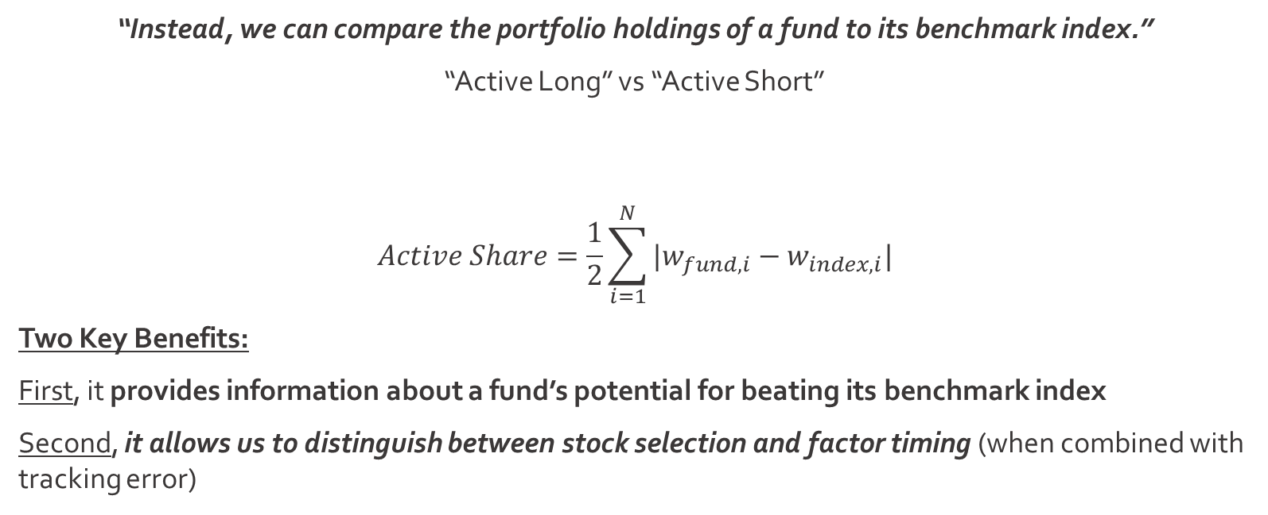
Active Share
WSU
Definitions
The New Way:
“Instead, we can compare the portfolio holdings of a fund to its benchmark index.”
“Active Long” vs “Active Short”
$$Active Share=\frac{1}{2}\sum_{i=1}^{N}{|w_{fund,i}−w_{index,i}|}$$
Two Key Benefits:
First, it provides information about a fund’s potential for beating its benchmark index
Second, it allows us to distinguish between stock selection and factor timing (when combined with tracking error)
Overweighs a stock relative to the index weight
Underweights a stock (no purchase) relative to the index weight

Slide 5
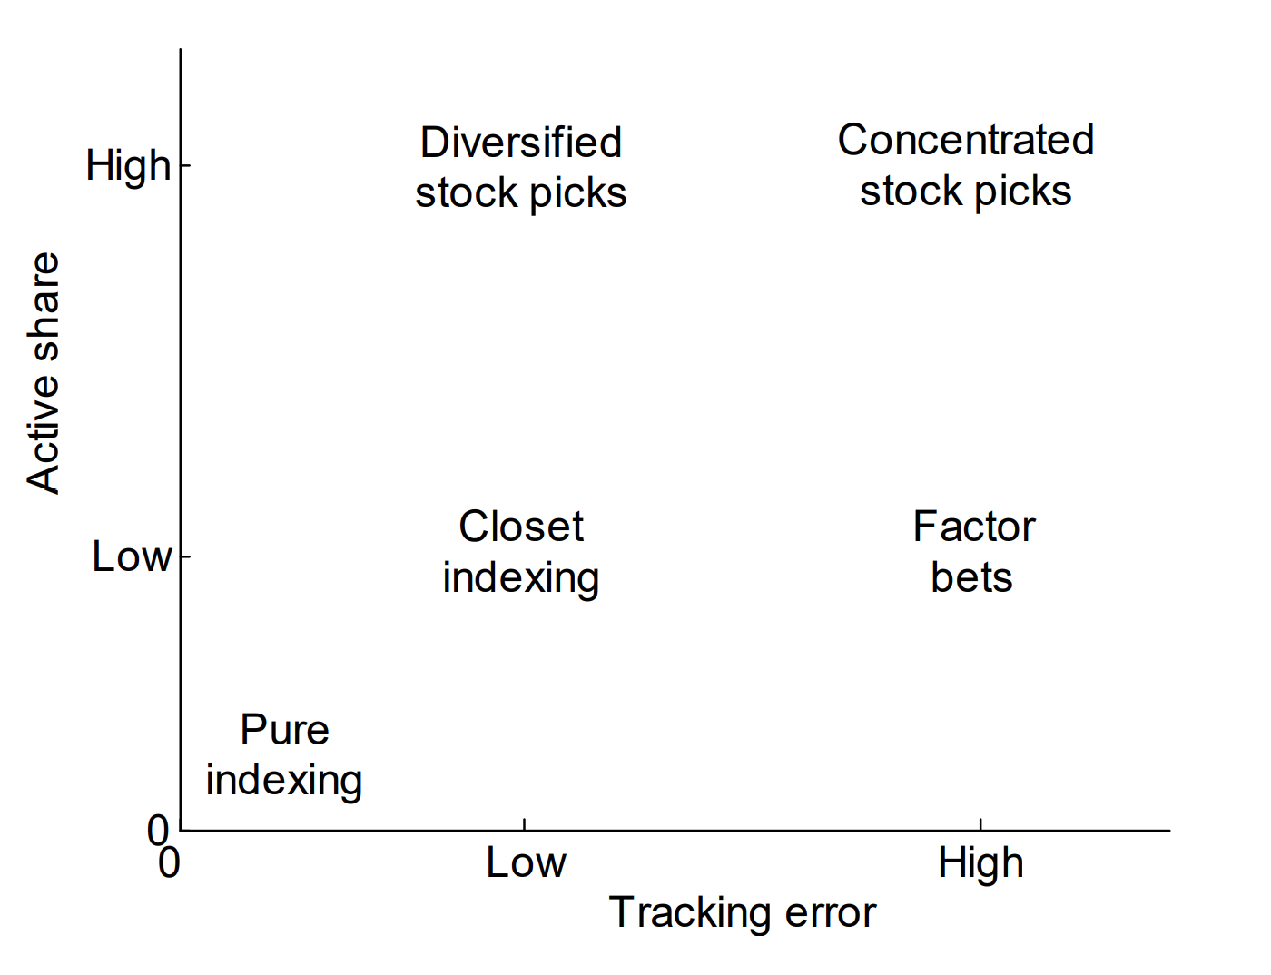
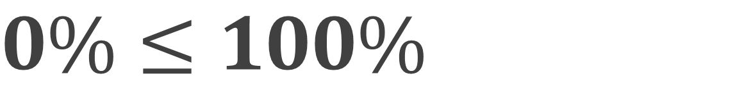
$$0\%≤100\%$$
WSU
Definitions
“Since mutual funds almost never take actual short positions, their Active Share will always be between zero and 100%.”
Conceptually,
The tracking error incorporates the covariance matrix of returns – putting significantly more weight on correlated active bets
Active Share puts equal weight on all active bets regardless of diversification
Ergo, tracking error proxies for factor bets and Active Share proxies for stock selection

Slide 6
Data Sources
WSU
Data
“Another important feature separating our paper from many others in the literature is the data.”
First, 19 Indexes
Authors include essentially all indexes used by the funds themselves over the sample period
In total, 19 indexes from three index families are included: S&P/Barra, Russell, and Wilshire/Dow Jones
Second, Daily Data
Daily returns for mutual funds come from multiple sources:
The main source is Standard and Poor’s
This is supplemented by the CRSP mutual fund database and Wall Street Web (Goetzmann et al., 2001)
Daily benchmark return data come from CRSP or the indexes self reporting

Slide 7
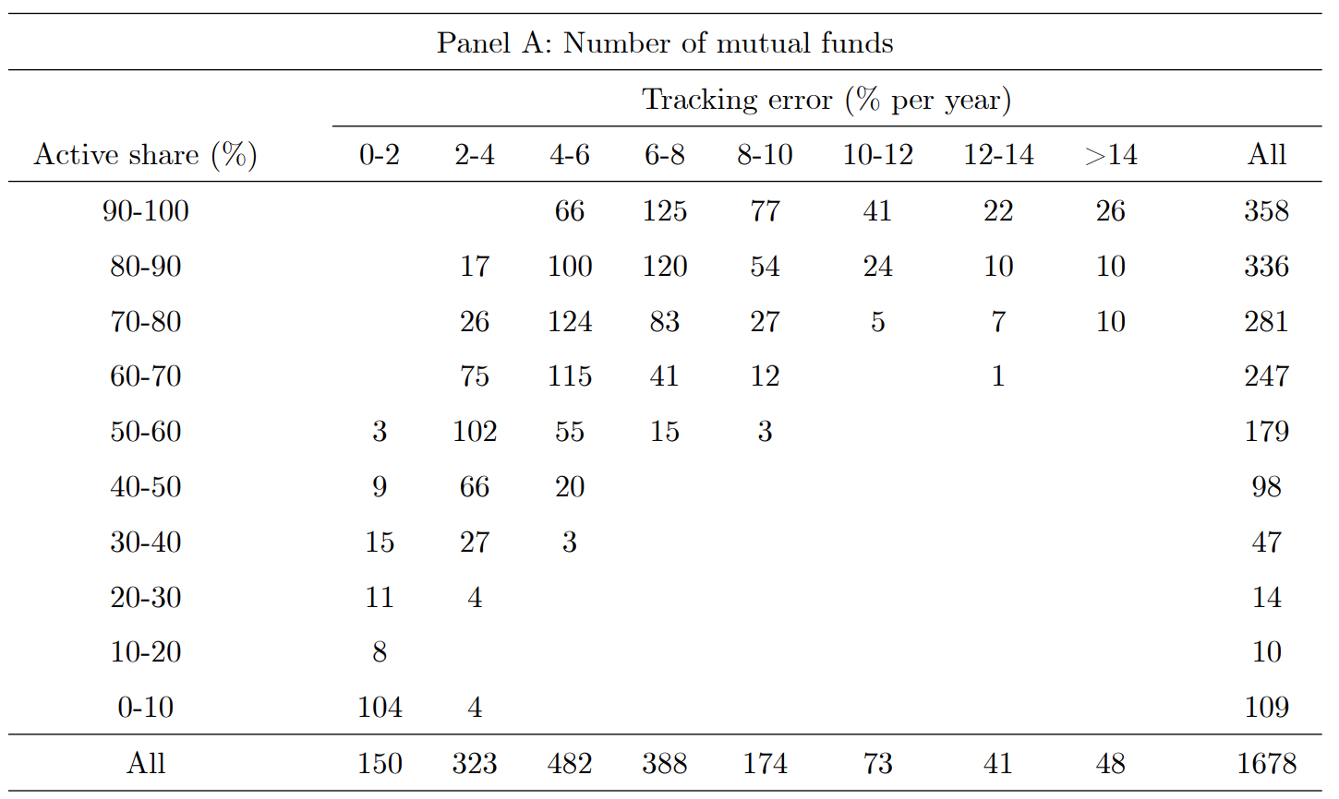
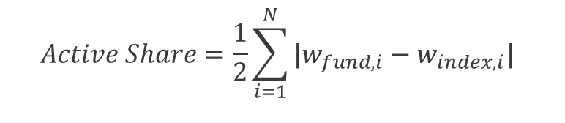
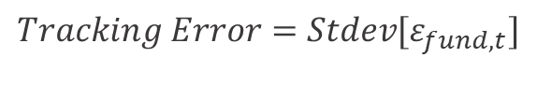
Methodology
WSU
Data
$$Active Share=\frac{1}{2}\sum_{i=1}^{N}{|w_{fund,i}−w_{index,i}|}$$
$$Tracking Error=Stdev[ε_{fund,t}]$$
Benchmark Index Selection:
19 Indexes
Fund_{j,t}
Benchmark
Active Share_{j,t}

Slide 8
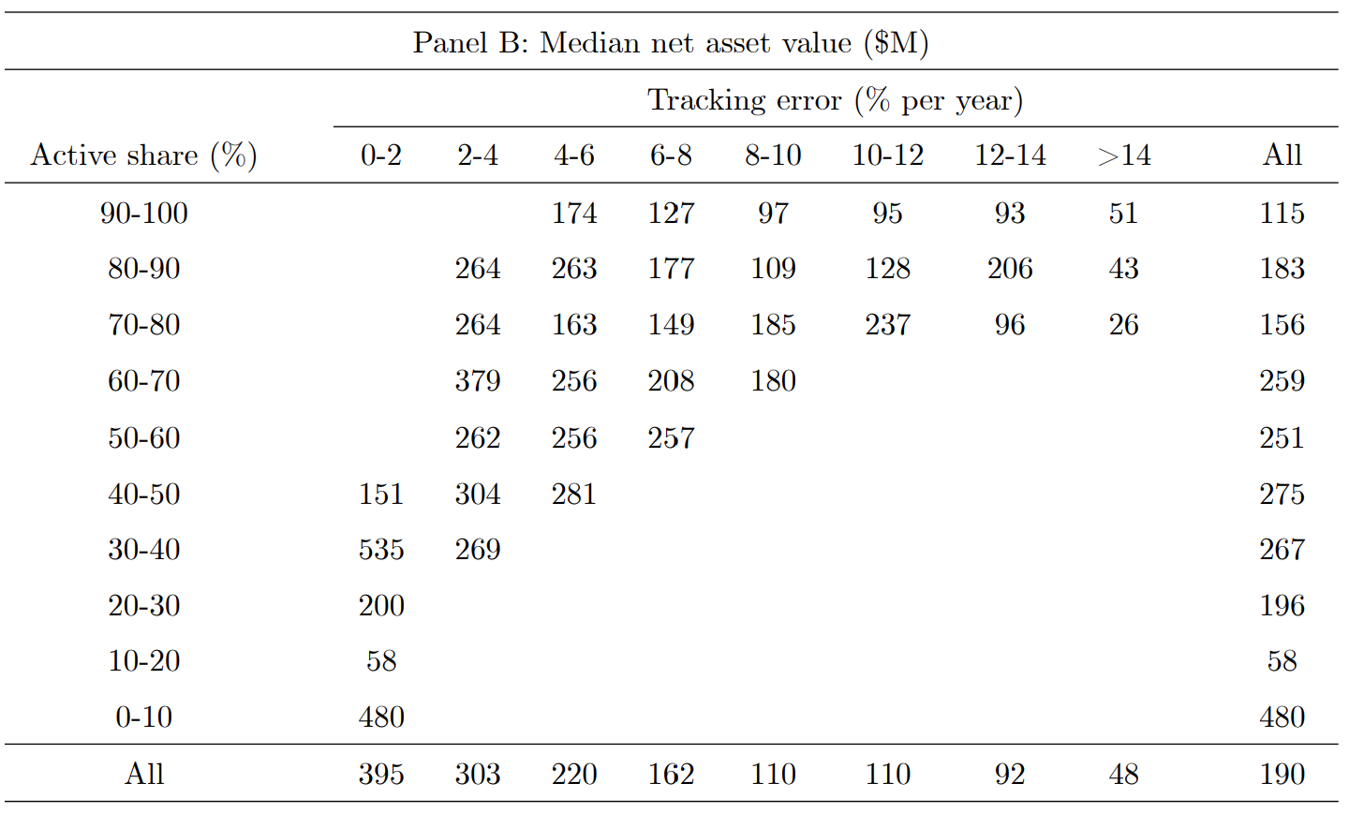
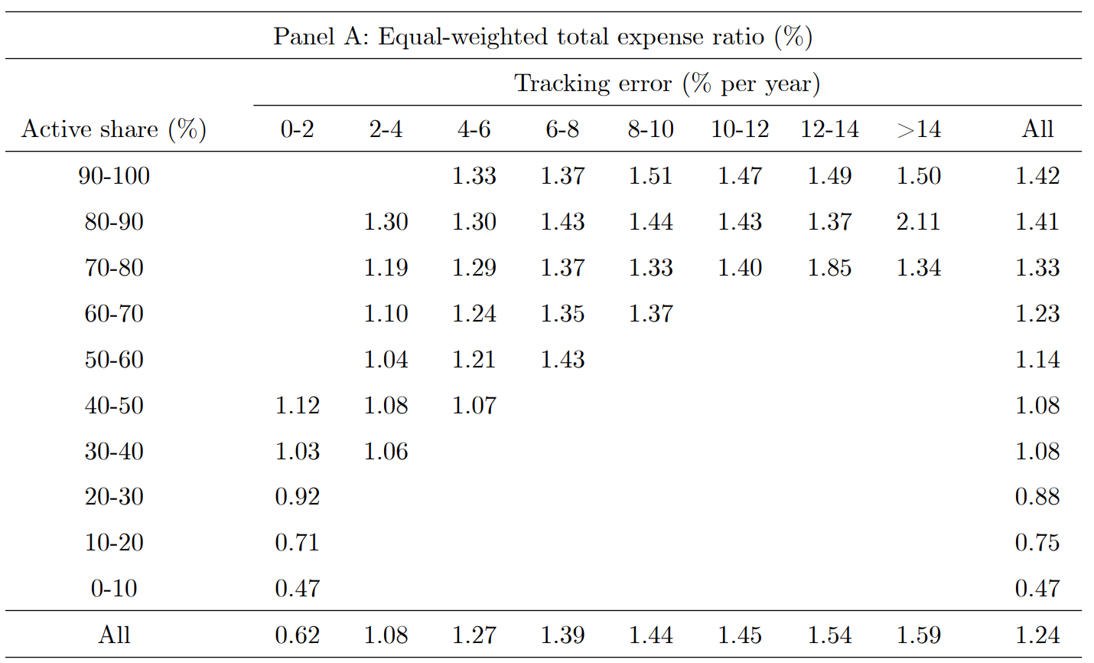
Active Management
WSU
Results
Size & Active Management
Fees & Active Management
70% Marginal $USD
1.24% Avg.

Slide 9
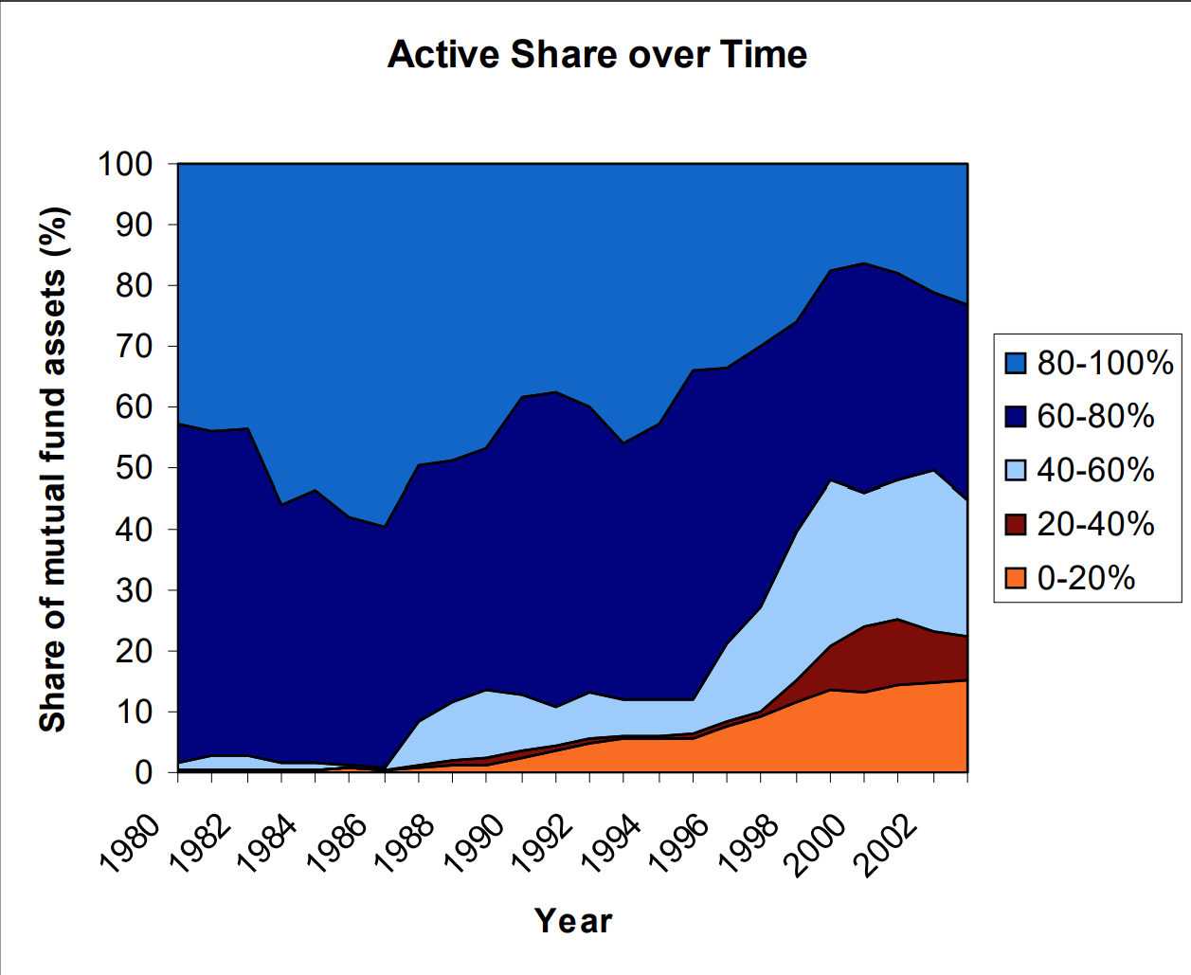
Fund Performance
WSU
Results
“Prior studies show that the average fund slightly outperforms the market before expenses and underperforms after expenses… the more active the fund, the higher its average gross return.”
“We pick 1990-2003 as our sample period.”
Avg fund loses by 0.43% per year, 1.14% when controlling for the 4-factor model
Difference between 1/5 active share is 2.55% per year, 2.98% with 4-factor
Active Share (highest) funds beat their benchmarks by 2.40%
While these higher funds do have higher trading costs, this is more than offset

Slide 10
Controversy
WSU
Outside Research
A bridge to far?
Morningstar
“Unfortunately, the authors… took the much bolder step of claiming that active share conveys merit.”
The Great Disappointment of Active Share | Morningstar
The Wall Street Journal
“There’s a lot that active share isn’t capturing.” – Russel Kinnel
How ‘Active’ Is Your Fund Manager? | WSJ
Fidelity
“Active Share: A Misunderstood Measure in Manager Selection.”
Active Share Study | Fidelity Investments

Slide 11



Conclusions
WSU
“This new methodology also allows us to empirically identify different types of active management: diversified stock picks, concentrated stock picks, factor bets, closet indexing, and pure indexing.”
Evidence is presented for the belief that small funds are more active, while the largest funds are closet indexers (> $1bn in assets)
The shift from active to passive management over the 90’s is due in larger part to closet indexers than index funds
Active management significantly predicts fund performance

